Slide 1

PROJECT PRESENTATION
BILLING SYSTEM
IN PYTHON
Presented by -
JOEL GEORGE GEMINI
GOURAV L R
AMOGH KRISHNA K
POORNIMA J URS
JEEVANA V

Slide 2


CONTENTS
1
Introduction
6
User Interface Design
2
Problem Statement
7
System Flow
3
Key Features
8
Code Overview
4
Objectives
9
Challenges Faced
5
Technology Stack
10
Conclusion & Future Enhancements

Slide 3


INTRODUCTION
Overview: A Python-based billing system designed for retail, using a GUI built with Tkinter.
Purpose: Streamlines the billing process, automates calculations, and generates bills efficiently.
Key Features:
- Dynamic quantity adjustment.
- Bill generation in PDF format.
- Easy management of customer transactions.
Ideal for small businesses seeking a simple and efficient billing solution.

Slide 4


Manual Billing Inefficiencies: Traditional billing processes in small retail stores are often time-consuming and prone to errors.
Need for Automation: Calculating total amounts, applying taxes, and generating bills manually can lead to inaccuracies and delays.
User Convenience: Lack of an easy-to-use system for store owners to quickly generate and save bills.
Solution: A simple, automated billing software that streamlines the entire billing process with dynamic product management and automated calculations.
PROBLEM STATEMENT

Slide 5

KEY FEATURES
User-Friendly Interface: Simple, intuitive design using Tkinter for easy navigation.
Dynamic Quantity Adjustment: Users can increase or decrease item quantities in real-time.
Automated Calculations: Total price and tax are calculated automatically based on selected items.
Bill Generation: Final bills are saved directly as PDF files for easy storage and printing.
Error Handling: Ensures valid input for quantities, preventing common user mistakes.

Slide 6


OBJECTIVES
AUTOMATE BILLING
PRODUCT MANAGEMENT
Create a user-friendly system to automate the billing process for small retail stores.
Allow dynamic input of product quantities with automatic total calculation.
ERROR-FREE CALCULATIONS
BILL GENERATION
Ensure accurate and real-time updates for total price and tax during billing.
Generate and save bills quickly in PDF format for easy record-keeping.

Slide 7
TECHNOLOGY STACK
Python
Python: Core programming language for the application.
Tkinter: GUI library used for creating the application interface.
FPDF: Python library used to generate PDF bills.
Random: Python module to generate unique bill numbers.
PIL (Pillow): For saving the generated PDF file.
Tkinter
FPDF
Random
PIL (Pillow)

Slide 8
USER INTERFACE DESIGN
Tkinter GUI
Input Fields
Simple, easy-to-navigate interface for billing.
Fields for customer details and product quantities.
Bill display area with automatic scrolling.
Customer name, phone number, and bill number.
Product quantities with add/remove buttons.
Output
Real-time bill preview in the bill area.
Option to generate and download the final bill as a PDF.

Slide 9
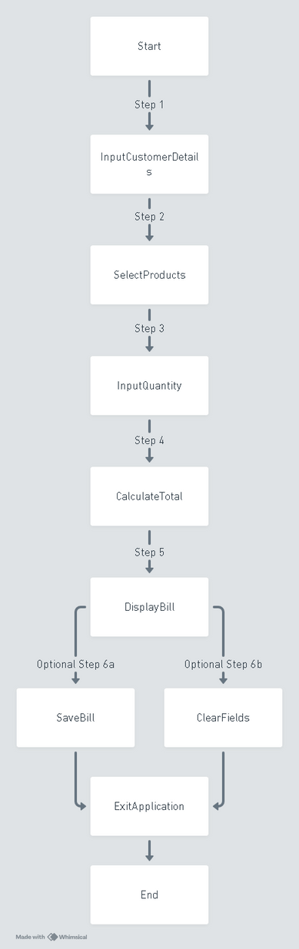
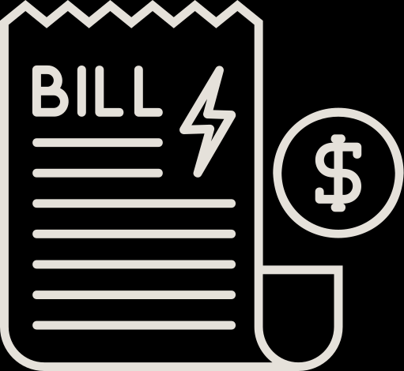
SYSTEM FLOW
1. Start:
- Application launches.
2. Customer Input:
- Enter customer details: name, phone number, and bill number.
3. Product Selection:
- Choose products from the list.
- Adjust quantities using increment/decrement buttons.
4. Bill Generation:
- Click on "Total Bill" to calculate total price and tax.
- Display detailed bill in the bill area.
5. Save/Export:
- Option to save the bill as a text file or download as PDF.
6. Clear/Exit:
- Clear fields for a new transaction or exit the application.

Slide 10
CODE OVERVIEW
1. Main Class - `Bill_App`:
- The core functionality is encapsulated in the `Bill_App` class, where the entire billing system logic is implemented.
- It initializes the graphical user interface (GUI) and handles user interactions.
2. GUI Setup:
- The app uses `Tkinter` for the user interface.
- It consists of different sections: title, customer details, product list, bill area, and billing summary.
3. Product Management:
- A dictionary is used to store product names along with their respective quantity and price.
- Users can input the quantity for each product, and the system will calculate the total based on predefined prices.

Slide 11
CODE OVERVIEW
4.Bill Area:
- The bill area displays all the products, quantities, prices, and the final bill, including tax.
- Real-time bill updates are shown as users enter the quantities.
5.Total Calculation:
- The `total` method calculates the total price and applies a 5% tax.
- The total amount is displayed in the billing summary and printed in the bill area.
6.Saving the Bill:
- The `save_bill` method allows users to save the bill as a `.pdf` file with the unique bill number.
7.Other Functionalities:
- Clear function resets all fields for new billing.
- Exit function provides safe closure with user confirmation.

Slide 12

CHALLENGES FACED
UI Design & Layout:
Dynamic Data Management
Organizing multiple components in a user-friendly layout and ensuring the design was responsive to various screen sizes.
Handling real-time updates for product quantities, calculating totals, and saving bills accurately posed technical challenges.

Slide 13

CONCLUSION AND FUTURE ENHANCEMENTS:
CONCLUSION-
This billing software simplifies retail transactions by automating the billing process, providing accurate calculations, and generating downloadable bills. It's an efficient tool for small businesses.
FUTURE ENHANCEMENTS-
Database Integration: Implement a database to store customer and product details, making it more scalable.
Barcode Scanning: Integrate barcode scanning for quicker product entry and improved accuracy.

Slide 14

THANK
YOU
for your time and attention

